Slide 1
Model view set class

Slide 2
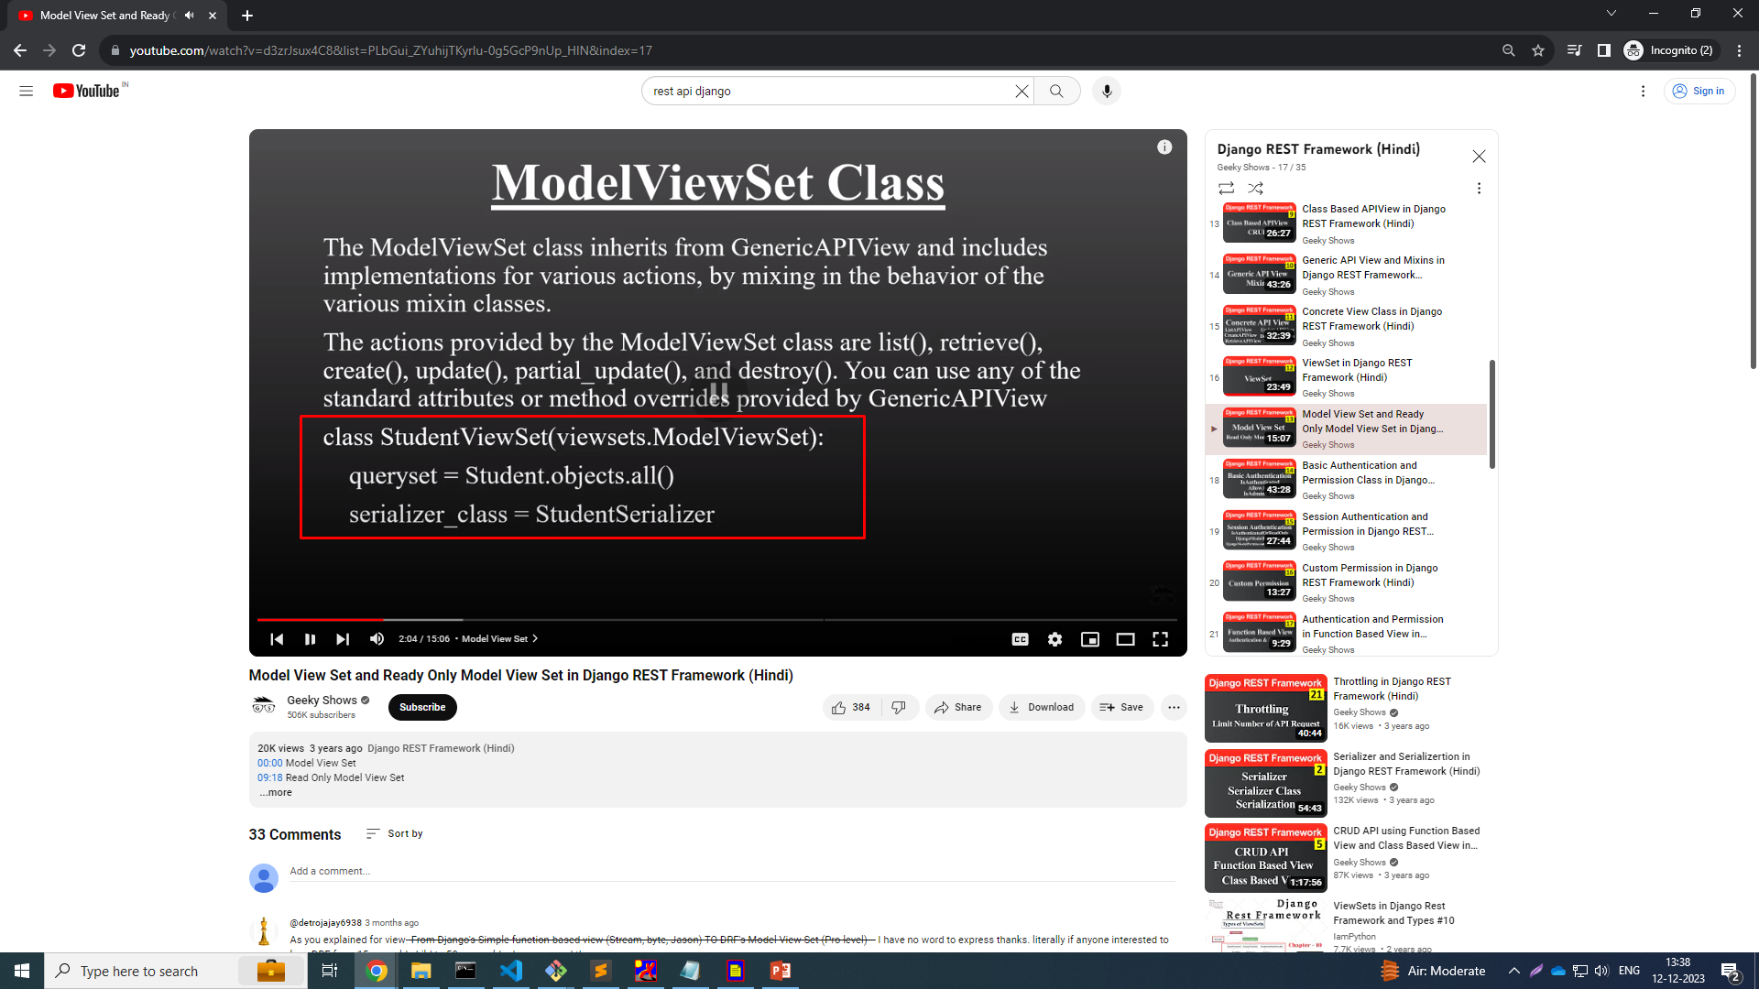

Slide 3
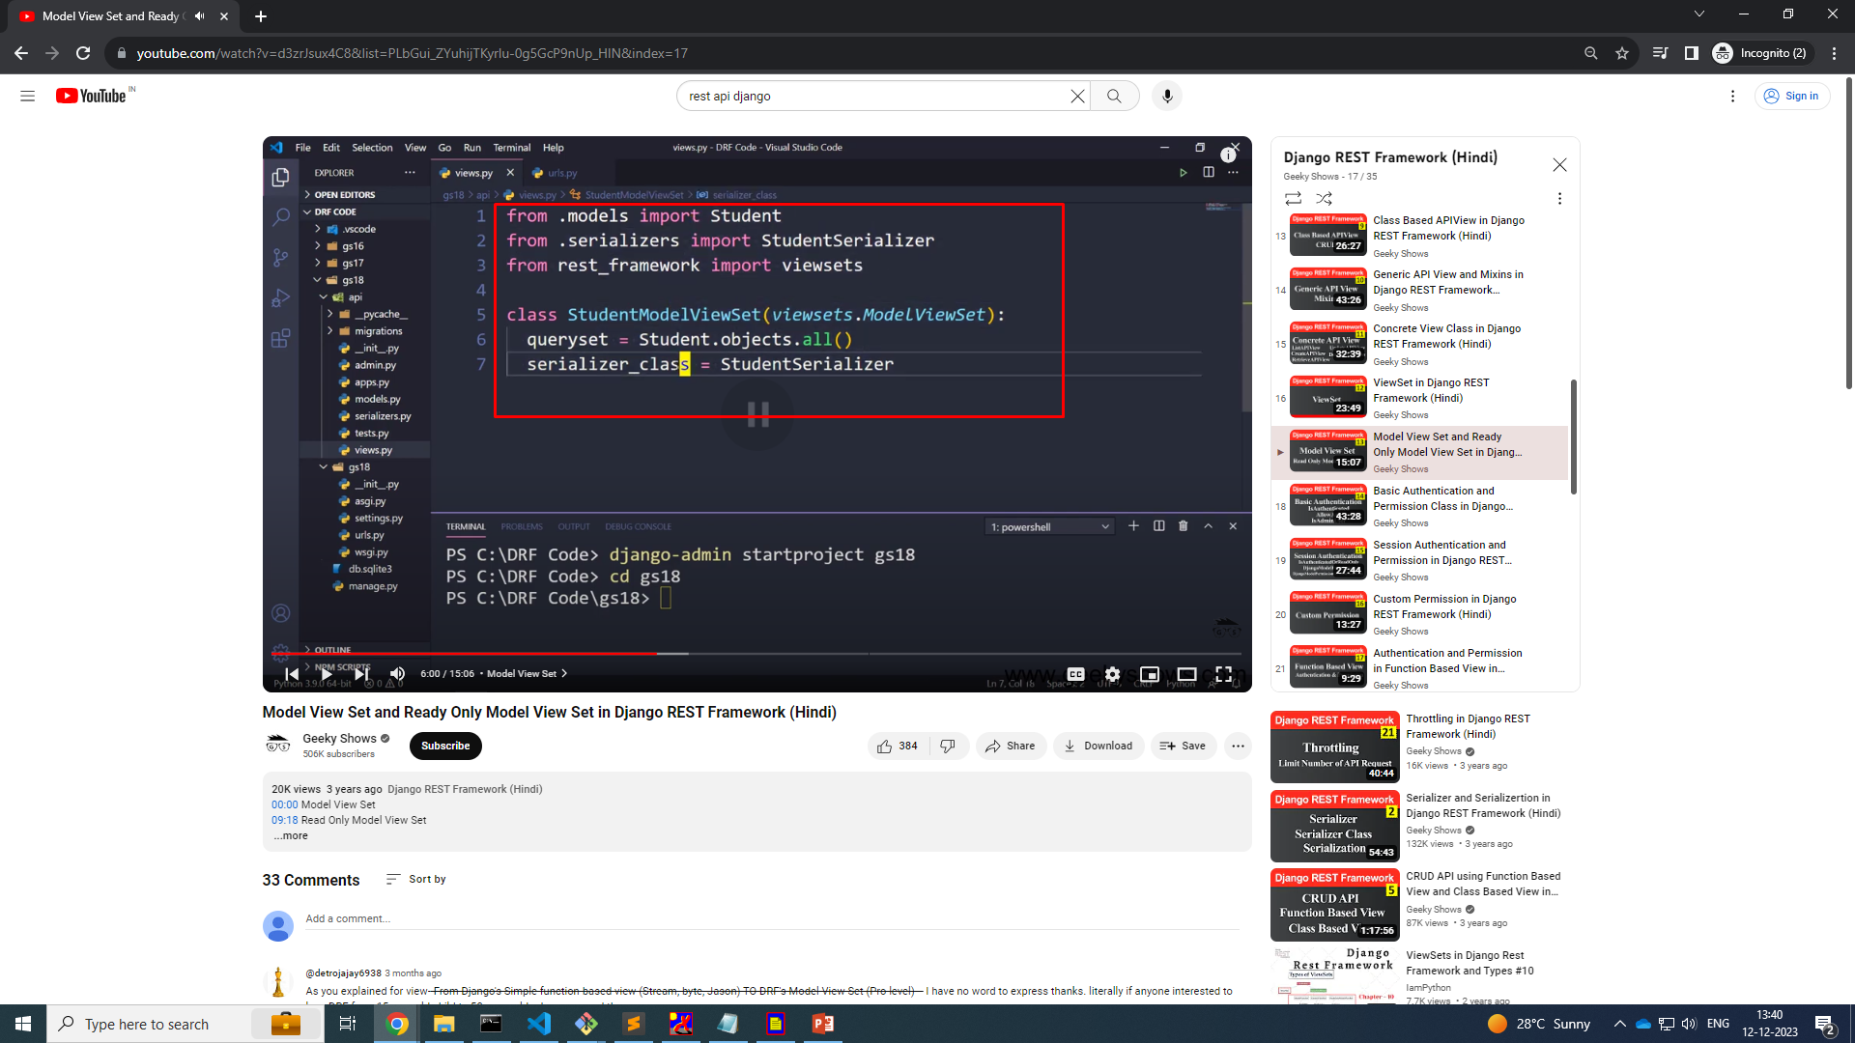
CRUD API

Slide 4
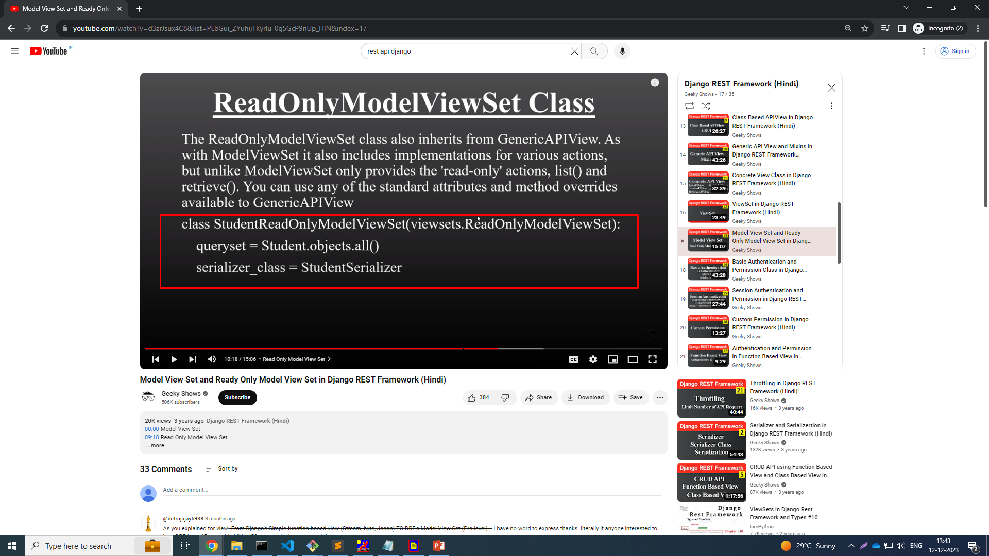
React Only Model View Set

Slide 5


Slide 6
Urls.py
from django.contrib import admin
from django.urls import path,include
from .import views
from rest_framework.routers import DefaultRouter
router = DefaultRouter()
router.register('location-api', views.getLocations, basename="location")
router.register('location', views.Location, basename='go-location')
router.register('readonly-locaton-api',views.ReadOnlyLocation, basename="readonly_api")
urlpatterns = [
path('',views.getHome,name='service'),
path('api/',include(router.urls)),
]

Slide 7
Views.py
from django.shortcuts import render
from django.http import HttpResponse
from rest_framework.parsers import JSONParser
from rest_framework.renderers import JSONRenderer
from .models import Location
from .serializer import LocationSerializer
# Create your views here.
from rest_framework.response import Response
from rest_framework import status, viewsets
## read only model view sets
class ReadOnlyLocation(viewsets.ReadOnlyModelViewSet):
queryset = Location.objects.all()
serializer_class = LocationSerializer

Slide 8
Views.py
## model view set
class Location(viewsets.ModelViewSet):
queryset = Location.objects.all()
serializer_class = LocationSerializer
class getLocations(viewsets.ViewSet):
def list(self,request):
locationData = Location.objects.all()
srlData = LocationSerializer(locationData, many=True)
return Response(srlData.data)
def retrieve(self, request, pk=None):
id = pk
if id is not None:
locationData = Location.objects.get(id=id)
srlData = LocationSerializer(locationData)
return Response(srlData.data)
def create(self, request):
return Response(10)

